Slide 1
Decision Making (Intro to Learning)
GAM 376

Slide 2
Decision Making
The ability for a character to decide what to do
Most games stick with simple systems
Game might not demand sophisticated behaviors
Examples
State Machines, Behavior trees
Higher Level systems often rarer but have increasing in demand
Fuzzy Logic, Neural Networks, RuleBased Systems, Goal-Driven Behavior

Slide 3
Decision Making
Zombie Game
Behavior tree with some goal-driven elements
We will explore each one separately
State Machines (quick review)
Decision Trees
Behavior Trees (quick review)
Fuzzy Logic
Goal-Driven Behavior
Rule Based Systems

Slide 4
Decision Making
Although there are many techniques, we can look at them in the same way
Character processes a set of info to generate an action to carry out
The input to the decision making system is the knowledge that a character possesses and the output is an action request

Slide 5
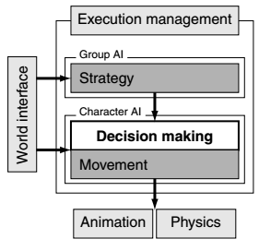
Decision Making
The input to the decision making system is the knowledge that a character possesses and the output is an action request

Slide 6
AI Model
Knowledge can be further broken down into external and internal knowledge
External knowledge is the information that a character knows about the game environment
Position of other characters, Layout of level, etc.
Internal knowledge is information about the characters internal state
Health, goals, previous states

Slide 7
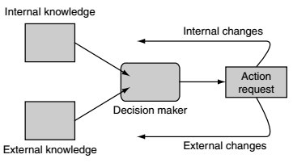
AI Model
Knowledge is sent to the decision maker (BT, Fuzzy, Goal) then will request a action
Actions can be either external or internal
External: State of character (firing weapon, moving)
Internal: Changing internal data (state, goal)

Slide 8
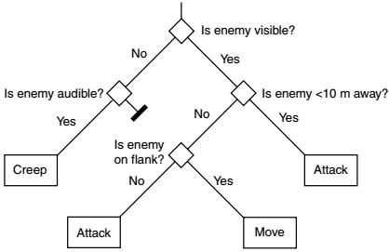
Decision Trees
Decision Trees
Fast, easily implemented, simple to understand
Very modular, easy to create.
Algorithm

Slide 9
Decision Tree: Algorithm
Each choice is made based on the character’s knowledge
Often just refers global game state, rather than personal knowledge
The algorithm continues along the tree making choices at each decision node until the process has no more decisions to consider
At each leaf an action is attached.
When reached the action is executed immediately

Slide 10
Decision Tree: Algorithm
Decisions in the tree are simple
Typically checks a single value
Don’t contain any Boolean logic
I.e. No AND/Ors
Representative sets examples:

Slide 11
Decision Trees
Data Type | Decisions
Boolean | Value is True
Enumeration | Matches one of a given set of values
Numeric value (int, floats) | Value is within a given range
Vector | Vector’s length within a given range

Slide 12
Example
Imagine guard at a military facility
Guard makes decisions based on the current alert status of the base
Green, Yellow, Red, Black
Board Example:

Slide 13
Pseudo-Code
Decision Tree Classes
Decision Tree Node
Specifies a method used to perform the decision tree algorithm
Action
Contains details of the action to run when the tree arrives there
Decision (Recursive)
TrueNode & False Node
pointers to other nodes in the tree
TestValue
points to piece of data in the character’s knowledge
GetBranch
Returns the branch which to follow after decision

Slide 14
Fuzzy Logic
So Fart decisions made have been very cut and dried
True or false
Fuzzy logic is a set of mathematical techniques designed to cope with gray areas

Slide 15
Fuzzy Logic
Imagine an AI character moving through a dangerious environment.
In a FSM approach, we choose two states
“Cautious” or “Confident”
When “Cautious”
Character moves slowly, sneaky and keeping an eye out for trouble
When “Confident”
Walks normaly
It might look weird in game
Hard switches between states

Slide 16
Fuzzy Logic
Fuzzy logic is popular in games, but it not so much in general AI
Remember Game AI is about the illusion of intelligence
Short version
Always better to use probability to represent uncertaintity
Example,
If you play a betting game any player who is not basing their decisions on probability theory can expect to eventually lose his money. Reason is that flaws in any other theory of uncertainty, besides probability can be exploited by an opponent.

Slide 17
Fuzzy Logic
Part of the reason of why its popular in video games is that probability calculations can be slow.

Slide 18
Fuzzy Sets: Predicates
Predicate
Quality or description of something
Example
If character is hungry, “hunger” is a predicate
Every character does or doesn’t have it.
Predicates can be viewed as sets
Everything to which the predicate applies is in the set, otherwise outside the set

Slide 19
Fuzzy Sets: Predicates
Predicates are given a value
Example:
Hurt (0.5), Hunger(0.9)
Character with a high value (0.7) will be affected then a character with a low value
So rather then predicates being exclusively in or out of a set.
Predicates can partially belong to many sets
These sets are called Fuzzy sets

Slide 20
Fuzzy Sets: Degree of Membership
Each predicate has a degree of membership
How much does it belong to the set
Example, a value 0.9 has a 0.9 degree of membership
If a predicate has a DOM of 1 it completely in the fuzzy set.
Alternative, 0 is completely outside
Do not confuse values as probability or percentage!

Slide 21
Multiple Sets
Anything can be members of multiple sets at the same time
All degree of memberships should total to 1
i.e. Character can’t have hunger of 0.4 and healthy of 0.7
Even though its not rigidly enforced, you should try your best to enforce it.

Slide 22
Fuzzification
Fuzzification
Turning data to degrees of membership
Oppisite: defuzzification
Most common fuzzification technique is turning a numeric value into membership of one or more fuzzy sets
i.e. Using character hit points as “healthy”

Slide 23
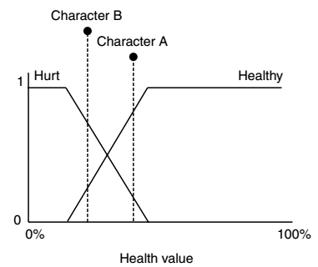
Fuzzification

Slide 24
Fuzzification
You can fuzzify other data types as well
Even though might be more rigid
Example
“HasRocket” is Boolean value
Its fuzzy value will have membership value of either 0 or 1
Same Idea applies with enumerated types
Defuzzification is the reverse
Taking DOM and turning it into a single output for the character to use

Slide 25
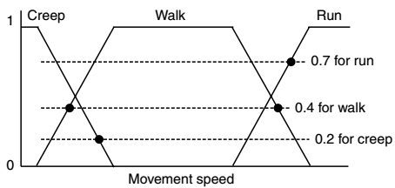
Impossible defuzzification

Slide 26
Highest Membership
Easiest method for us to chose which action to use is to always pick the highest
Run has highest value so 0.7 will be used for speed
Alternate Approaches
Average, Bisector curves, etc

Slide 27
Fuzzy Rules
Fuzzy Rules are set of if-then rules with precondition and consequents
i.e. if precondition then consequents
Consider or Steering Behavior Ship
Rule 1:
IF distance is Near THEN speed Slow
Rule 2:
IF distance is Medium THEN speed Medium
Rule 3:
IF distance is Far THEN speed Fast

Slide 28
Fuzzy Rule Algorithm
3 steps
1. Fuzzification
Determining the membership value of the input in the different fuzzy sets
2. Fuzzy Rules
Apply fuzzy rules to the fuzzified input in order to determine the fuzzy output
3. Defuzz
Fuzzy output is converted back to readable value

Slide 29
Example
Consider car rounding a corner
Rule Block
Corner-Entry AND going-fast THEN brake
Corner-Exit AND going-fast THEN accel
Corner-Entry AND going-slow THEN accel
Corner-Exit AND going-slow THEN accel

Slide 30
Example
Consider car rounding a corner
Degrees of Membership:
Corner-Entry: 0.1
Corner-Exit: 0.9
Going-Fast: 0.4
Going-Slow: 0.6
Now process result from rules

Slide 31
Example
Consider car rounding a corner
Results from rule process (minimum)
Brake = min(0.1,0.4) = 0.1
Accelerate = min(0.9, 0.4) = 0.4
Accelerate = min(0.1, 0.6) = 0.1
Accelerate = min(0.9, 0.6) = 0.6
So final value for Brake is 0.1 and Accelerate is 0.6 (taking max)

Slide 32
Psuedo Code
Now will go through some pseudo code

Slide 33
Analysis
Now this implementation is simple but lacks scalability
Due to amount of values to process
Its is recommended to use Combs Method to help creating rules
This will have the number of rules scale linearly with the number of input states.
Link: https://en.wikipedia.org/wiki/Combs_method

Slide 34
Behavior Trees & Goal Oriented Behaviors
Now for a Zombie game we mixed elements of both into our implementation
But lets now focus on actual Goal Oriented Behaviors
New ideas, sequences of actions, success and failure.

Slide 35
Goal Oriented Behavior
Goal oriented action planning allows a character to perform a sequence of actions to satisfy a goal
Now lets go through an example to understand GOB

Slide 36
Scenario
Wood Cutter
Character’s goal is to chop wood and bring it back to the base
Goal:
MakeFireWood
Actions:
ChopLog, GetAxe, CollectBranches

Slide 37
Actions
ChopLog
Will turn a log into firewood, as long as wood cutter has an axe
GetAxe
Will give wood cutter an axe
Collect Branches
Produces firewood as well without requiring axe but lower quality

Slide 38
Goal
MakeFirewood
2 different action sequences
Needs firewood -> GetAxe -> ChopLog = makes firewood
Needs Firewood -> CollectBranches = makes firewood

Slide 39
Goal
If agent can get axe then they chop for firewood
Otherwise it will collect branches
Each sequence will fulfill the goal of MakeFirewood
Board Demo

Slide 40
Goal Oriented Behavior
This process decouples actions from each other unlike FSM
Further you can add or remove actions on the fly
More dynamic

Slide 41
Actions
You can also apply cost to actions (like the influence value)
Then player will chose lowest cost sequence of actions. Values can change, giving character more dynamic behavior
So lets look at the Wood Cutter again with cost applied.

Slide 42
Actions
Actions have preconditions and effects
Preconditions
State that is required for the action to run
Effects
Change to the state after the action has run
Example,
ChopLog requires an Axe
If Axe is unavailable then it will find another action with a precondition that it can fufill.

Slide 43
Planner
Planner is a piece of code that looks at actions’ preconditions and effects and creates queues of actions that to perform
Board example with pseudo code
With woodsman

Slide 44
Procedural Preconditions
Preconditions can be a little smarter rather then run or don’t run
i.e. Axe is available or no axe available
For example
Analyze Axe vinicity
Axe could be nearby or to close to enemies which could influence the overall decision.
Downside
Can take a while to process

Slide 45
Coding Example
We will go over a unity example using Goal driven behavior
Source code found & info here
Link

